Slide 1
Welcome to ALM Quality Center Client Launcher Webinar We will start shortly…

Slide 2
ALM Quality Center Client Launcher
MF SaaS Technical Solutions Consultant
Notes:
I will mute everybody for the next 20 minutes and then open up for questioning during the last 10 minutes for Q&A session.

Slide 3
Agenda
1. Installation and Configuration of ALM Client Launcher
2. Command Line Options
3. OTA Registration
4. UFT Integration
5. Embedded browser for SSO Authentication
6. Access ALM, Lab Management, and Site Admin URL
7. Known Limitations
8. Q&A
2
Notes:
The agenda is given here.
We have 7 agenda items to go over follow by a Q&A session.
I will mute everybody for the next 20 minutes and then open up for questioning during the last 10 minutes for Q&A session.
The topics are followed:
1. How to install and configure ALM Client Launcher
2. What are some of the available command line options that you can use
3. How to register OTA for 3rd party integration tools
4. What behavior to expect for UFT Integration
5. How to switch to using embeded web browser window for SSO authentication
6. How access the ALM, Lab Mangement, and Site ADmin URL
7. Known limitaion
Lastly Q&A session

Slide 4
What is the ALM Client Launcher?
ALM Client Launcher is a lightweight, portable, and flexible tool that enables you to run an ALM client on any Windows machine with no need for Internet Explorer or admin permissions
Notes:
-To begin our discussion, I would first like to talk a little bit about what is the Client Launcher and why should we use it?
- ALM Client Launcher is a lightweight, portable, and flexible tool that enables you to run an ALM client on any Windows machine with no need for Internet Explorer or admin permissions
- ALM Client Launcher was first introduced in ALM 12.6
- The most current version available on the marketplace web site is version 3.1
- A common question here is why do we want to use the Client Launcher?
There are 2 main reasons for using the ALM Client Launcher:
1. You are no longer required use IE or Edge as the ALM Client
2. No Admin permission is needed to install the tool nor is it needed to register OTA

Slide 5
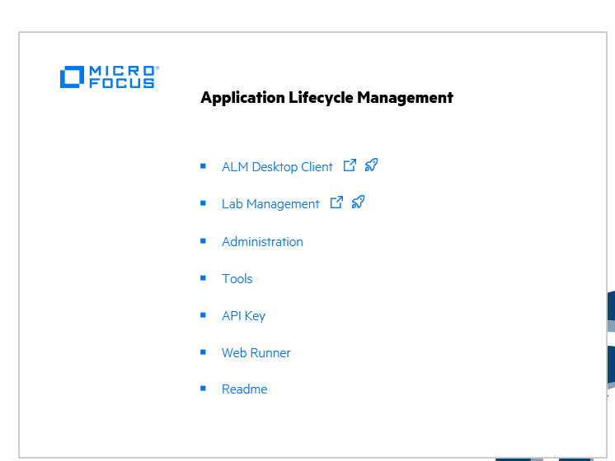
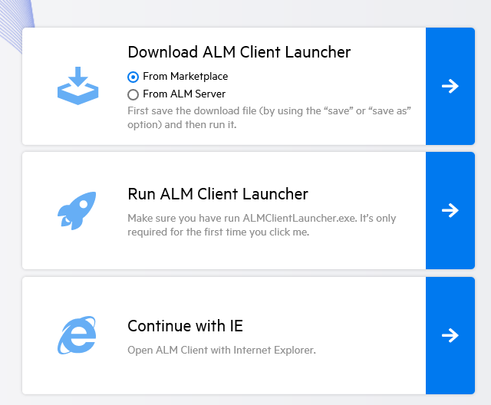
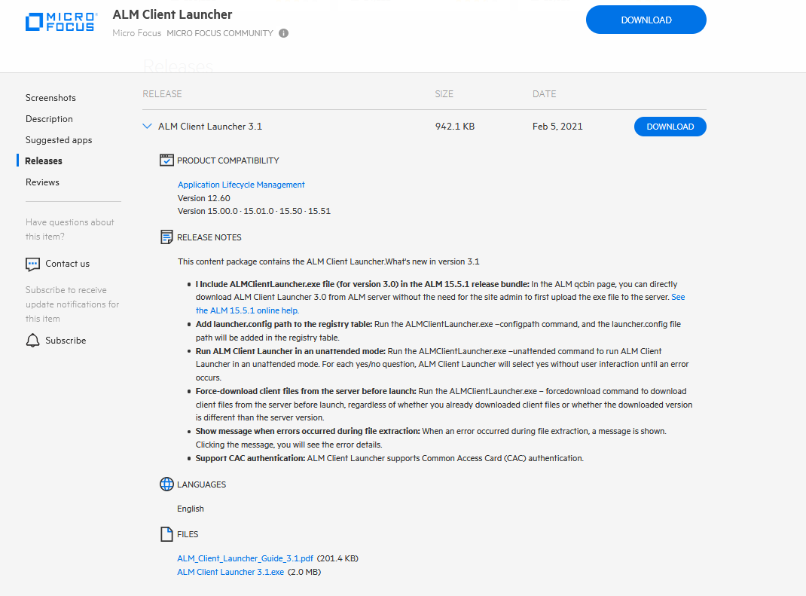
Download ALM Client Launcher
https://marketplace.microfocus.com/appdelivery/content/alm-client-launcher
Notes:
- Now that we know what is the ALM Client Launcher. Next step is how do we get the tool?
- You can download the Launcher by directly going to the Micro Focus Markeplace or from the main page of ALM.
- In the main you, you want to click on the shuttle button icon.
- This will bring you to the Launcher download site.
- You will see 2 options
1. Download from the Marketplace
2. Download from the ALM server
- Suggestion is to download from the marketplace since it has the most up to date version which is 3.1
- Version that you get from ALM server is only 3.0 so not recommended.
- There are 2 files that will be downloaded
1. An ALMClientLauncher.exe
2. A User's Guide pdf file
- You want to read the User's Guide before preceeding futher

Slide 6
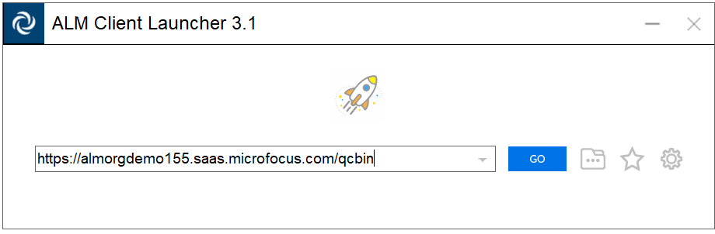
Provide ALM QC URL
Execute the ALM Client Launcher executable
Provide the ALM Client URL
Notes:
- The ALM Client Launcher is just an executable.
- You can't access ALM with just the tool.
- You will need to install the client files and configure the application.
- Once you bring up the Client Launcher, the initial step is to enter the URL of your ALM server that you want to access

Slide 7
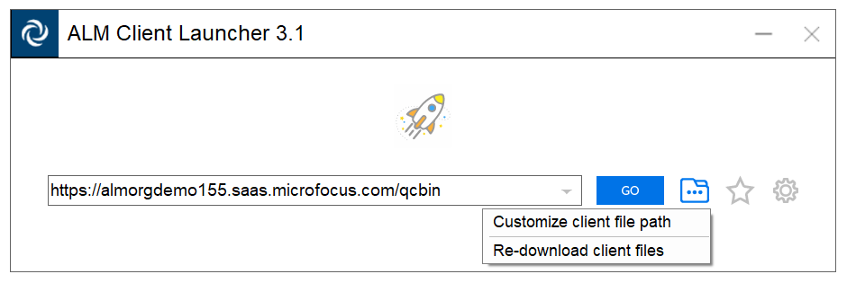
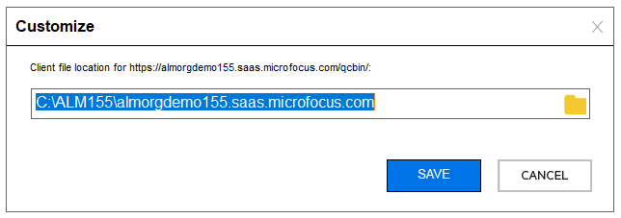
Specified Installation Path
Specify a location where you have full permission
Notes:
- Next you need to specify the local installation path. Where do you want to place your client files.
- In the ALM Client Launcher.
2. Enter your server URL
3. Click on the "Customize" button
4. Select "Customize Client Path"
5. Enter your installation directory
- This now your installtion directory.
- Your client files will reside in this location
- The tool will associate the ALM URL with this installation path
- You need to make sure that you have full permission to installation directory
- If permission is lacking, then the tool may not be able to download and extract files to location

Slide 8
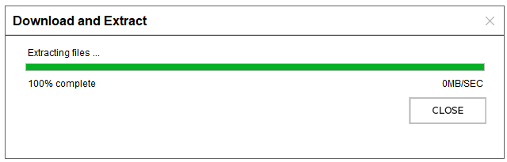
Download and Extract Client Files to Specified path
Download the zipped client files and extract to specified location
Notes:
- Once you have specify a location to download the file, you need to tell the tool to download the client zipped file from ALM Server
- This is down by doing the following:
1. Click on the "Customize" button
2. Select "Re-download client files"
- Launcher will automatically download and extract the client files to the path specified in the previous slide
- However, this may failed if you do not have permission to the folder or the ALM client file have not been placed on the server correctly
- Go back correct the folder permission if needed and open a ticket with Operation team if there is an issue with the file on the server

Slide 9
Manually downloading and extract client files
Download zip from you to your ALM instance
https://<ALMURL>/qcbin/Apps/ClientPackages/ALMClient.zip
Extract zip file to the installation directory
Example: C:\ALM155\almorgdemo155.saas.microfocus.com
3. In ALM Client Launcher, customize the installation path to point to Step 2.
Notes:
- As previously indicated, the ALM Client file was zipped and placed on the ALM server.
- The Client Launcher can automitically download and extact the files or you can do it manually.
- You can manually download the file by navigating to the URL below.
- Once you download the file, you can unzipped file to your instalaltion directory
- In the Client Laucher tool, click on "Customize" button
- Select "Customize Client Path" and enter your installation directory.

Slide 10
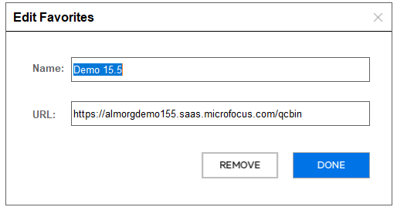
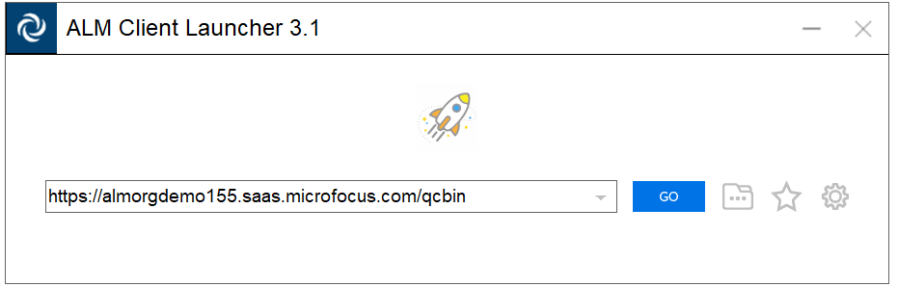
Save ALM URL as a favorite
Click on Add Favorite to save your settings
Notes:
- You can save your ALM URL by click on the "Edit Favorite" button
- Here you need to provide a name for your favorite and click on "Done"

Slide 11
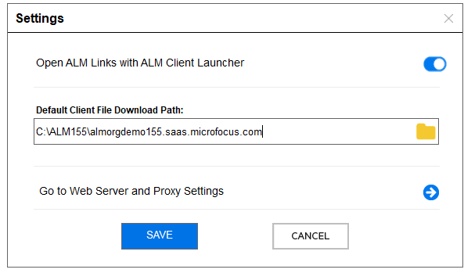
Settings: Allow ALM links to be open with ALM Launcher
Links in documents and other locations can invoke the ALM Client Launcher
Notes:
-Links to ALM can be embeded in defect auto emails
- You can have these links directly bring up Client Launcher
- This is done by enabling the "Open ALM Links with ALM Client Launcher"

Slide 12
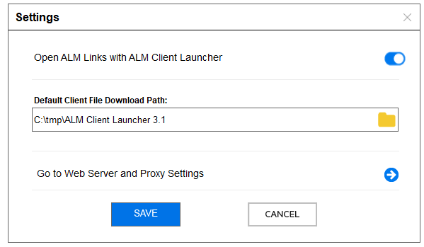
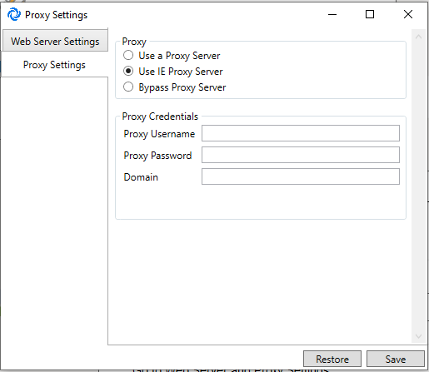
Settings: Configure Proxy
Click on Proxy Settings button to edit proxy information
Select “Use IE Proxy Server” setting only if proxy does not require user credentials
Notes:
- For users who need to access ALM behind a proxy
- You can edit the proxy configuration by clicking on "Settings"
- Click on "Go to Web Server and Proxy Settings"
- In the Proxy Settings dialog window, navigate to "Proxy Settings" pane
- Select the appropriate Proxy option.
- Please note that if you select "Use IE Proxy Server", then make sure that the proxy does not require a user credentials3

Slide 13
ALM Configuration file
Configuration file is saved under user profile by default:
Example:
C:\Users\<username>\AppData\Local\Launcher.config
Notes:
- The default configuration file will be saved under your user profile
- All your settings are saved in this file

Slide 14
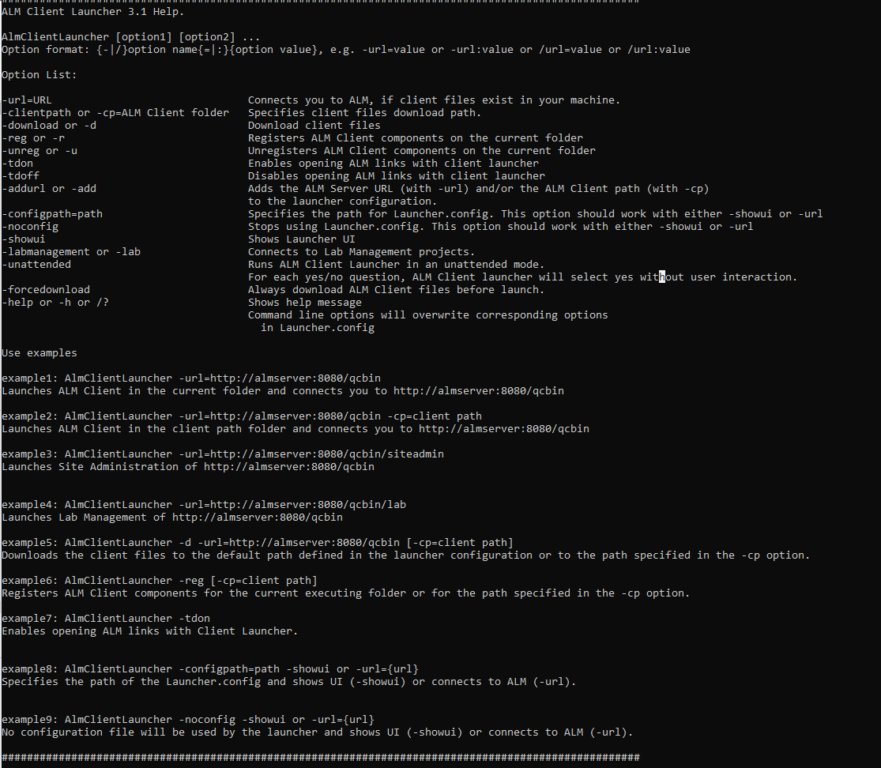
Command Lines
Use help command to list command line options:
ALMClientLauncher.exe /?
Notes:
- There are command line options that you can use to further configure the Client Launcher.
- User the /? command to get details help

Slide 15
Use Command Line to install in unattended mode
>ALMClientLauncher.exe –url=https://almorgdemo155.saas.microfocus.com/qcbin
-configpath=“c:\ALM155\almorgdemo155.saas.microfocus.com” -unattended
The command will do the following:
Bring up ALM Client Launcher and set to unattended (no user interaction) mode
Set client path to C:\ALM155\almorgdemo155.saas.microfocus.com
Download the ALMClient.zip file
Extract zipped file to c:\ALM155\almorgdemo155.saas.microfocus.com
Set Launcher.config file location to C:\ALM155\almorgdemo155.saas.microfocus.com
Notes:
- You can use command line options to download client file and set configuration and file path.
- Here we see a command line example
- This example will do the following:
1. Bring up ALM Client Launcher and set to unattended (no user interaction) mode
2. Set client path to C:\ALM155\almorgdemo155.saas.microfocus.com
3. Download the ALM Client zip file
4. Extract zipped file to c:\ALM155\almorgdemo155.saas.microfocus.com
5. Set Launcher.config file location to C:\ALM155\almorgdemo155.saas.microfocus.com
- So if you think that there are too many steps to perform previously, then you can provide the executable with just the command line

Slide 16
OTA Registration for 3rd parties Integration tools
>almclientlauncher.exe -reg -cp="c:\ALM155\ almorgdemo155.saas.microfocus.com"
Administration permission is NOT required
OTA will be registered under HKEY_CURRENT_USER in the registry
If you have OTA incompatibility issue due to previous installation, then run the ALM Client Cleanup tool to remove old version and re-register
Notes:
- In order to use OTA with other 3rd party tools, you will need to register the OTAClient.dll
- Here you will see an example of how to do the registration using command line
- Note you need to specify the location of the client file unless you have the executable under the same directory
- No Admin permissino is needed to register since you are writing to the HKEY_CURRENT_USER registry

Slide 17
Micro Focus Integration Tools OTA Requirements
*UFT will automatically download ALM Client files and register OTA overwriting Launcher's registration.
Notes:
- Here we have a list of the most common integration tools
- Most tools like Business View and Excel macro use REST so OTA registration is not required
- UFT does require OTA registration but it will download what it needs seperately
- You will need to register OTA for Word and 3rd party OTA Tools

Slide 18
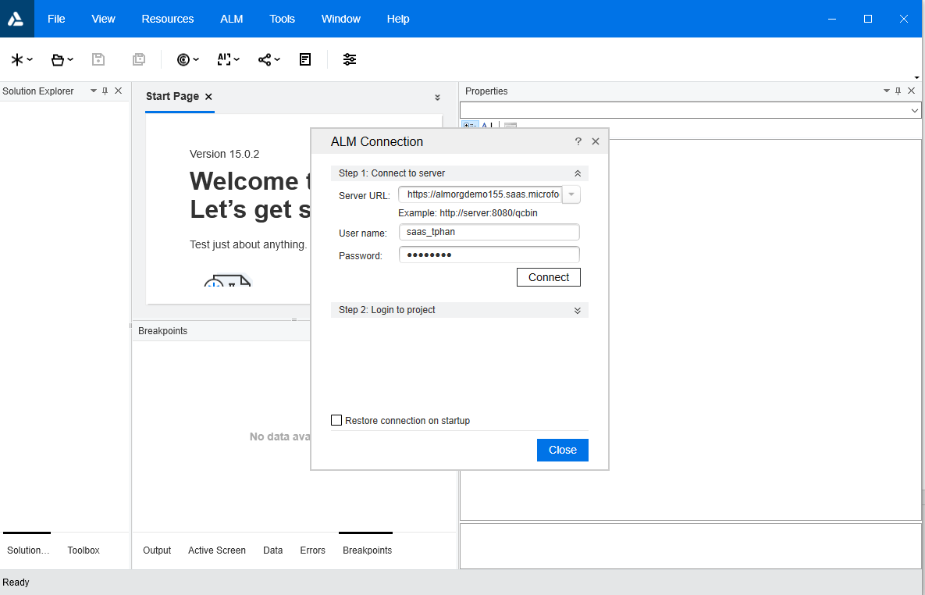
UFT Integration
UFT will automatically detect and download the ALM client files to C:\Users\<username>\AppData\Local\HP\ALM-Client
UFT (admin) will register OTA under HKEY_LOCAL_MACHINE
UFT (non-admin) will register OTA under HKEY_CURRENT_USER and will unregister OTA upon exit
UFT overwrite existing Client Launcher registration
Notes:
UFT requires OTA registration and ALM client files in order to connect to ALM.
However, UFT does not depends on ALM Client registration of OTA.
When UFT runs as admin, it will register OTA Client to HKEY_LOCAL_MACHINE and download all the client fields to default location under the user profile.
ALM Client Launcher registration command will register OTA to HKEY_CURRENT_USER.
HKEY_CURRENT_USER will take precedence over HKEY_LOCAL_MACHINE.
If UFT runs as a non-admin, it will also register HKEY_CURRENT_USER upon connection to ALM and un-register when it exits.
Therefore, it disregards and overwrites Launcher’s registration.

Slide 19
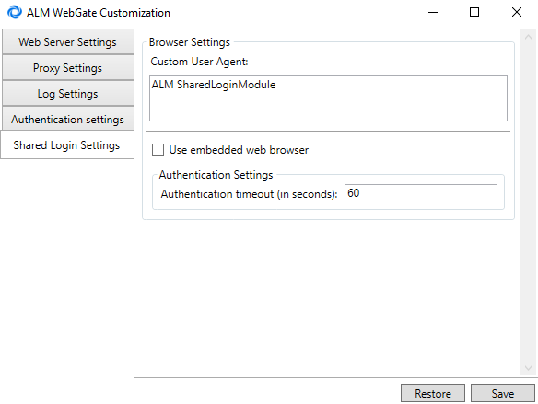
SSO Pop-up Authentication Window
By default, SSO authentication window uses the default Web Browser (IE)
For ALM 15.5.1:
ALM Webgate Customization tool is located under https://<sever>/qcbin/Apps
Use Client Launcher (embedded web browser) for authentication instead of Internet Explorer (default web browser)
DISABLE_SLM_WITH_DEFAULT_WEBBROWSER = Y (Site Admin parameter)
Notes:
- For SSO Authentication, a pop-box will appear upon clicking Go in the ALM Client Launcher.
- By default, this will use the “default” web browser window which is your IE browser.
- This window can be timeout resulting in failed authentication
- The window is seperate from Client Launcher window may not close after authentication has completed.
- You can switch to use embedded web browser (ALM Client Launcher) window for authentication by using the ALM WebGate Customization tool.
- Tools is located under htThis will close upon authentication and will not expired.
- Alterntaively, You can also set Site Parameter to Y.

Slide 20
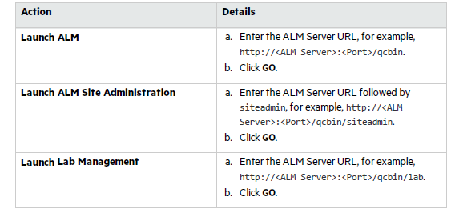
Launch ALM, Site Admin, and Lab Management
Notes:
-Now that you have everything configured, you can access ALM using Client Launcher.
- You can use the Client Launcher bring up the following Server URL:
1. ALM
2. Site Admin
3. Lab Management
Edit the URL and then Click on Go button

Slide 21
Limitations
Need browser to access SaaS Administration Add-on, API-Key Management, and Web Runner
SiteMinder external authentication is not supported
Supports only Windows
Notes:
-Here are some limitation to the Client Launcher.
Need browser to access Administration Add-on, API-Key Management, and Web Runner websites
-SiteMinder external authentication is not supported
-Supports only Windows

Slide 22

Inform Slides (Details On Slide 2)

Slide 23
Questions & Answers

Slide 24
www.microfocus.com

